Slide 1

Module 2.5 Safe internet use

Slide 2
Contents
Viruses
Computer worms
Trojans
Spam
Hoaxes and scams
Phishing
Pharming
Email spoofing
Activity 1
Guidelines for using the internet safely
Test and improve
Written module activity

Slide 3
Viruses
Software that disrupts normal functioning of a computer
Loaded on computer without knowledge or consent of user
Designed to create and exploit security loopholes
Try to reproduce and spread to other computers
Do not attack hardware – but software that manages and controls hardware

Slide 4
Viruses
How does a virus spread?
Infected …
email attachments
internet downloads
files shared on network
files on portable media
Most viruses activate when you run or open the infected file

Slide 5
Viruses
How do I know if I have a virus?
Files suddenly start disappearing
The computer slows down a lot
Programs stop working properly
Free space on the computer suddenly reduced greatly
Error messages not seen before start appearing
Computer no longer boots up
Anti-virus software reports presence or threat of a virus

Slide 6
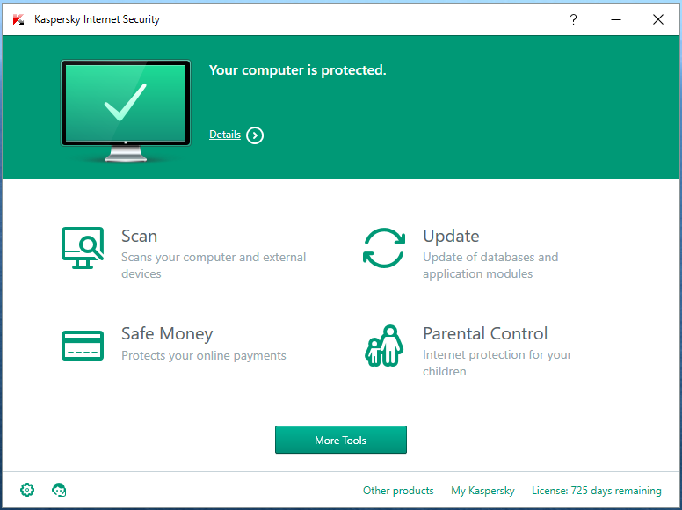
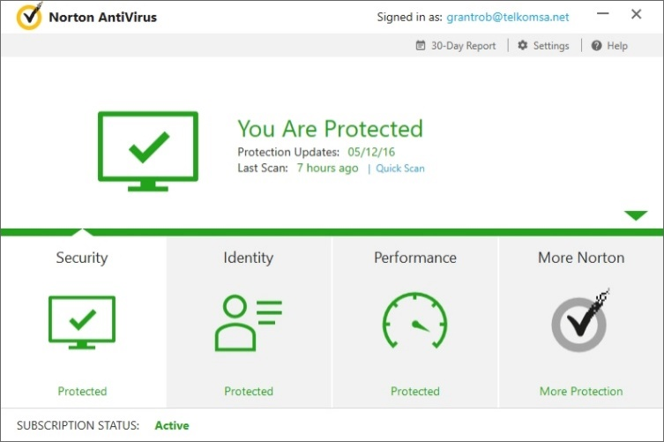
Viruses
Virus prevention
Anti-virus software can be configured to:
warn you of the presence of a virus on your computer
automatically delete any virus it detects
quarantine a virus

Slide 7
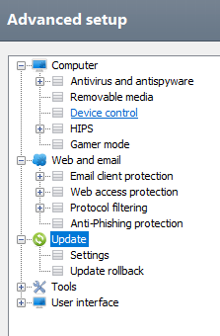
Viruses
Virus prevention
Prevent viruses by:
installing an anti-virus program
keeping your anti-virus software and definitions (signatures) up to date
scanning files stored on portable media (e.g. flash drives) before using them
scanning email attachments and downloaded files before opening them

Slide 8
Viruses
Virus prevention
Prevent viruses by (cont.):
setting your anti-virus software to scan incoming and outgoing email
avoiding pirated software – malware is often packaged with such software
not running programs obtained from untrusted sources

Slide 9
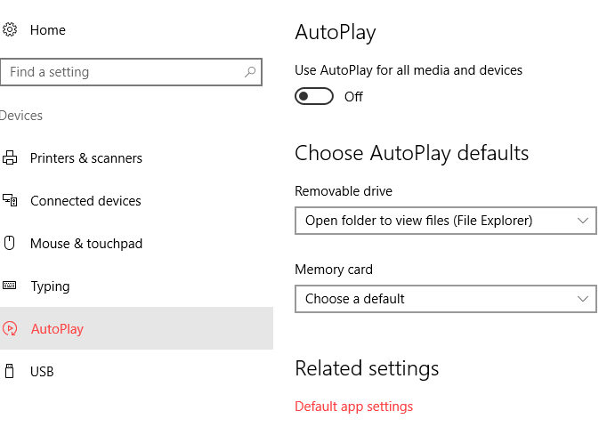
Viruses
Virus prevention
Prevent viruses by (cont.):
disabling the autorun feature for flash drives

Slide 10
Computer worms
Malware that is able to distribute itself over a network, normally via email, without a person running an infected program
Can reproduce itself many times – computer could send out hundreds of worms with devastating effect
Can cause computer to run very slowly and even crash
Prevention: Install anti-virus software on the computer (keep it updated!) and do not open unrecognized / suspicious emails

Slide 11
Trojans
Destructive program disguised as a useful application
Seems to be legitimate software
Deletes files on your computer, or scans it for personal information to send to person who created the Trojan
Games.exe
*.exe
Runme.exe
Prevention: Do not open attachments or run any programs
unless you are quite sure it is safe to do so

Slide 12

Spam
Email advertisements sent to you that you did not request ‘junk mail’

Slide 13
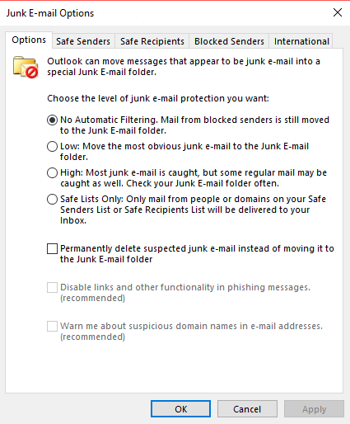
Spam
Prevention tips for spam
Be careful who you give your email address to
Check if your ISP can help – many ISP’s filter out spam
Investigate capabilities of your email program

Slide 14
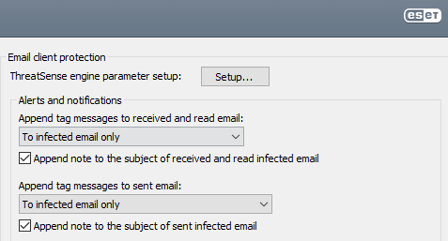

Spam
Prevention tips for spam (cont.)
Some anti-virus programs include anti-spam software
Mailwasher: specialised utility to filter out spam
Never respond to spam – just confirms a valid email address

Slide 15
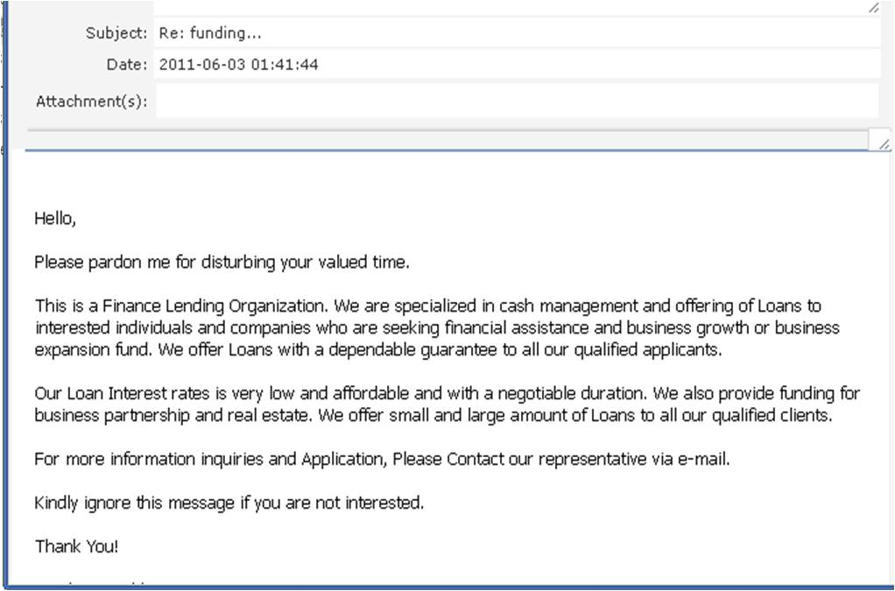

Hoaxes and scams
Internet hoax is an email message or article intended to deceive or defraud others

Slide 16
Hoaxes and scams
How to protect yourself from these
Never accept information at face value
Always check source of information
Often just a rumour – not based on fact
Just delete it – warn sender about the hoax
Be aware of virus hoaxes that encourage you to delete important files from your computer
Many websites investigate hoaxes and publish their results – visit these sites to check validity of messages

Slide 17
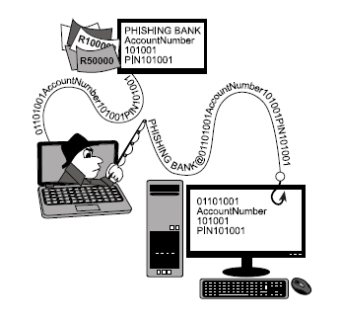
Phishing
Conning users into giving out personal and confidential details such as PIN numbers and passwords by posing as a legitimate organisation, (often a bank), usually via email.

Slide 18
Phishing
Prevention tips for phishing
Do not respond to email requests to confirm details like bank account numbers, PINs and passwords
Type in the URL of bank websites etc. directly – do not click on a link in an email to go to these sites
Check that site is secure
Secure site: https:// and not http://

Slide 19
Pharming
User is automatically redirected to another (fake) website even if he/she types in the correct URL for the official website
Criminal is able to use any data the user enters – usually passwords and PINs

Slide 20
Pharming
Prevention tips for pharming
Ensure you have up-to-date anti-spyware software installed
Many sites requiring secure information will warn you if you are redirected to another site – heed these warnings
Ensure that the site you are accessing is secure
Spyware: programs with bad intentions (malware) that try to monitor and record how you use your computer

Slide 21
Email spoofing
The changing of an email header (addressing part of the email) so that the email appears to come from a different source
Used in spam and phishing emails to disguise their origin – make the email seem more believable
spoofing

Slide 22
ACTIVITY 1

Slide 23
Guidelines for using the internet safely
General Guidelines
Keep operating system up to date
Keep anti-virus software definitions up to date
Be careful when installing software from the internet
Do not click on links in pop-ups
Be careful when opening attachments or programs – especially internet downloads
Have good password policies
Stay informed – keep abreast of news and tips
Don’t be gullible

Slide 24
Guidelines for using the internet safely
Good password policies
Don’t use personal information as a password
At least 8 characters long
Mixture of letters (upper and lower case), numbers and special symbols, e.g. S1T&pl&fg7
Use different passwords for different accounts
Change passwords them from time to time
Don’t write passwords down – remember them
Don’t give your passwords out!

Slide 25
Guidelines for using the internet safely
Interacting with others online – best practices
Do not give out personal details online
Do not make arrangements to meet in person with someone you met online
If someone makes you feel uncomfortable, discontinue the conversation and inform an adult
Remember – no posting on a social networking site can be regarded as private

Slide 26
Guidelines for using the internet safely
Interacting with others online (cont.)
It is acceptable to ignore friend requests from strangers on social networking sites
Be suspicious of someone who is just too ‘perfect’
Consider turning off the geotagging function on your mobile device – to keep your location secret

Slide 27
Test and improve
Summary – concepts, terms and tips
Malware
Computer worm
Trojan
Phishing
Pharming
Email spoofing
Hoaxes and scams
Spam
Virus
Prevention and protection
Using the internet safely

Slide 28
WRITTEN MODULE ACTIVITY

